Slide 1
Exploding Kittens
By: Kyle Fleskes,
Andrew Coates

Slide 2
01
Team Member’s Features
02
Monte Carlo Search Tree
TABLE OF CONTENTS
03
Neural Network
04
Generation of Training Data
05
Neural Network Training

Slide 3
01
Team Member’s Features

Slide 4
Team Member’s Accomplishments:
Kyle Fleskes:
Andrew Coates:
Monte Carlo Search Tree.
Neural Network.
Generation of Training Data.
Bug Fixing.
Training of neural network.
Exploding Kittens environment.
Tree integration with Exploding Kittens environment.
Bug Fixing.
Created Benchmarking.
Performance Analysis.

Slide 5
02
Monte Carlo Search Tree
Notes:
Introduce how AI impacts autonomous vehicles

Slide 6
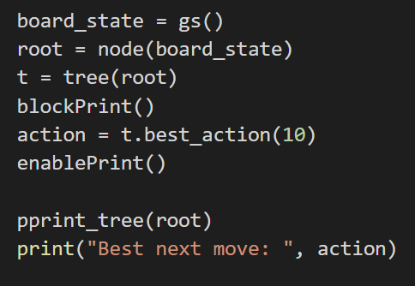
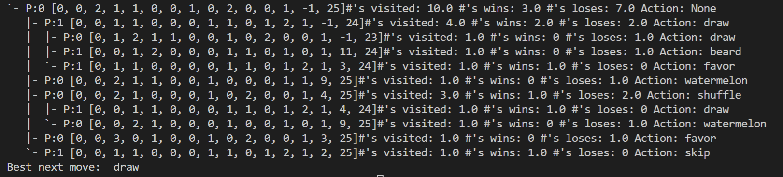
The Monte Carlo Search Tree Structure:

Slide 7
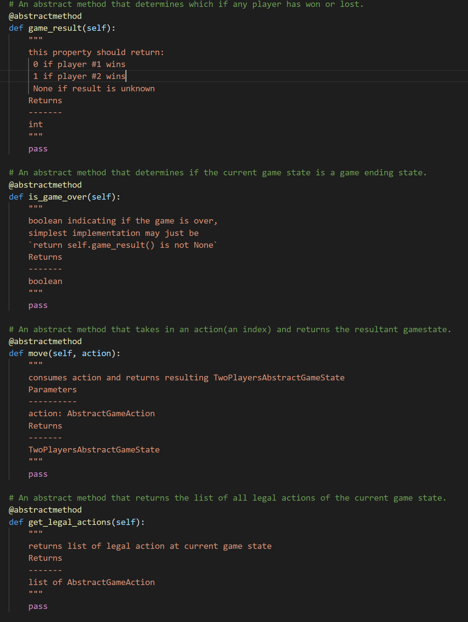
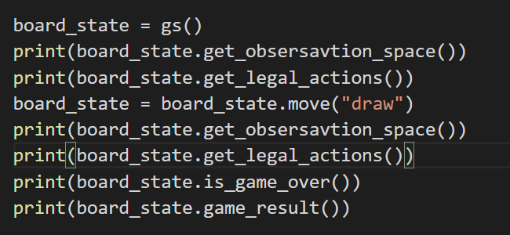
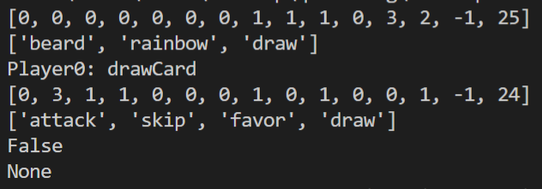
The Monte Carlo Search Tree Gamestate:

Slide 8
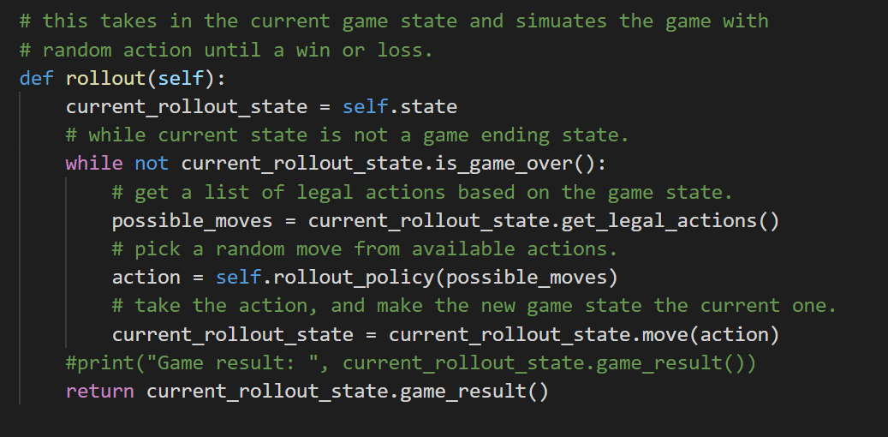
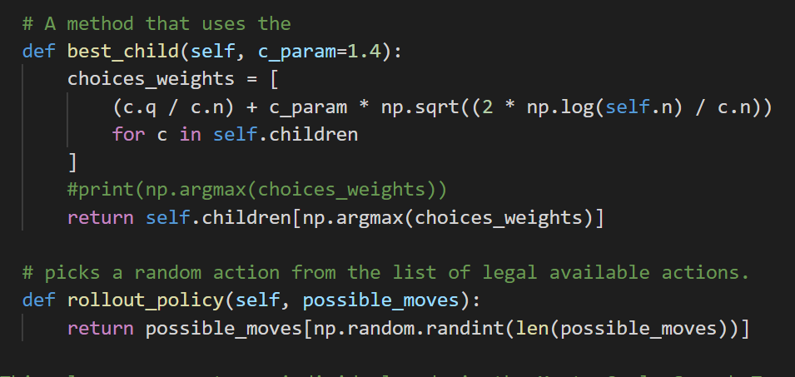
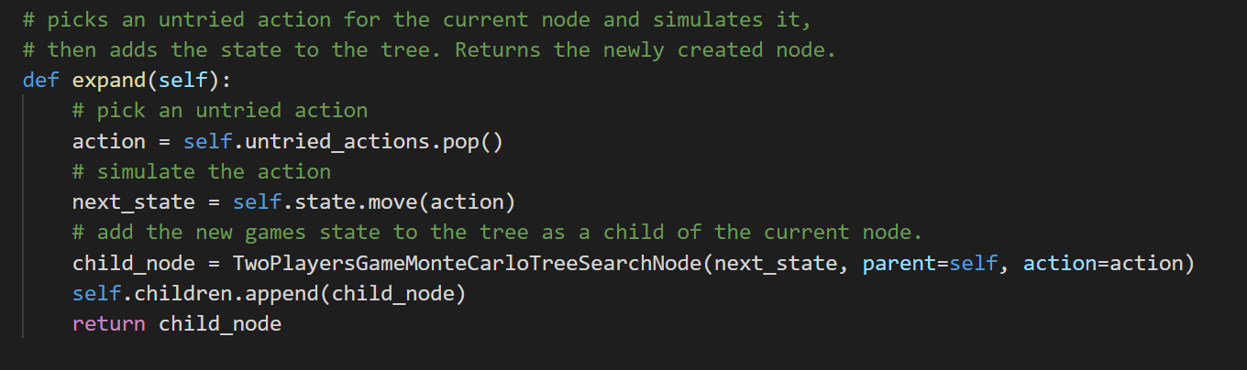
The Monte Carlo Search Tree Node:

Slide 9
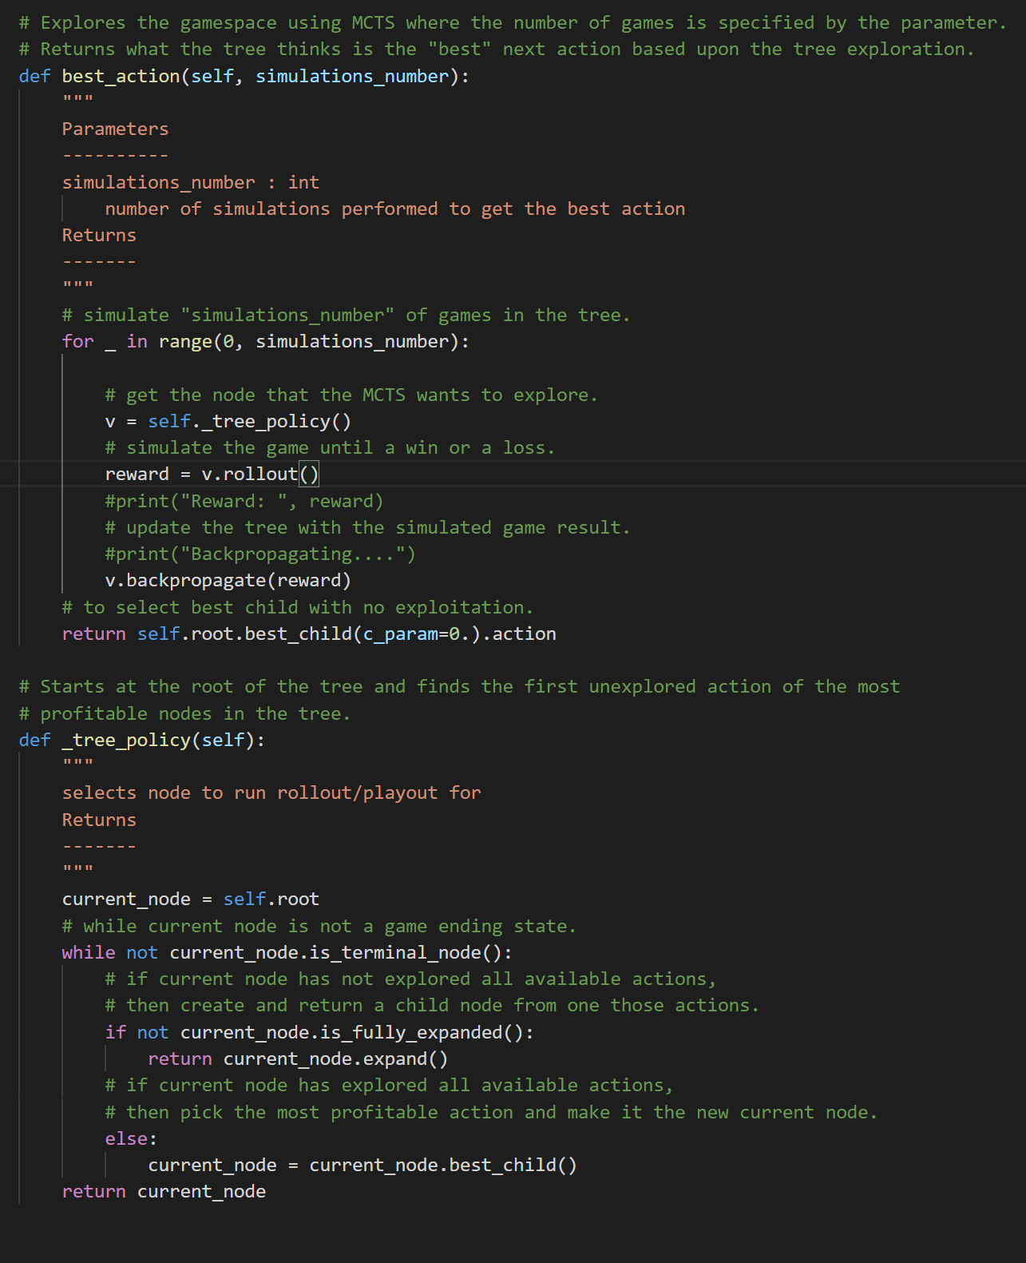
The Monte Carlo Search Tree:

Slide 10
03
Neural Network

Slide 11
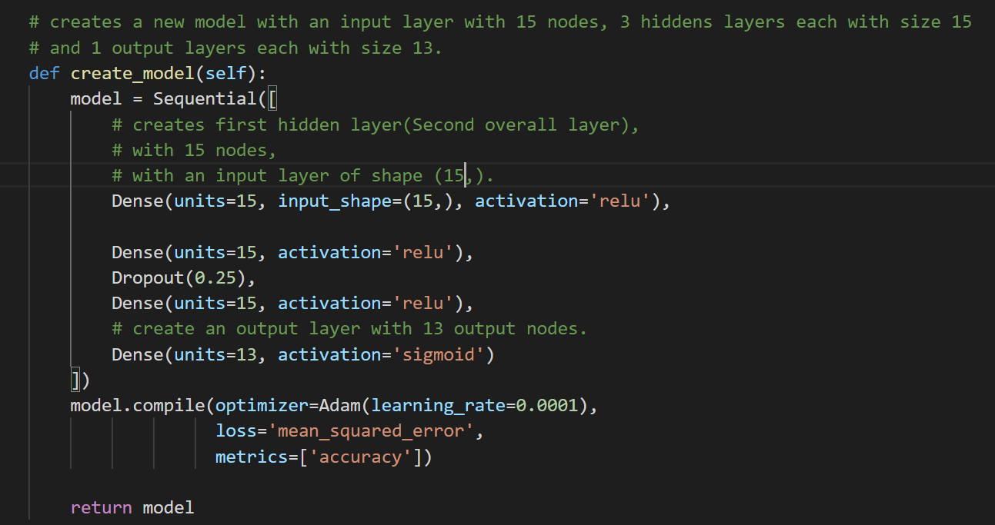
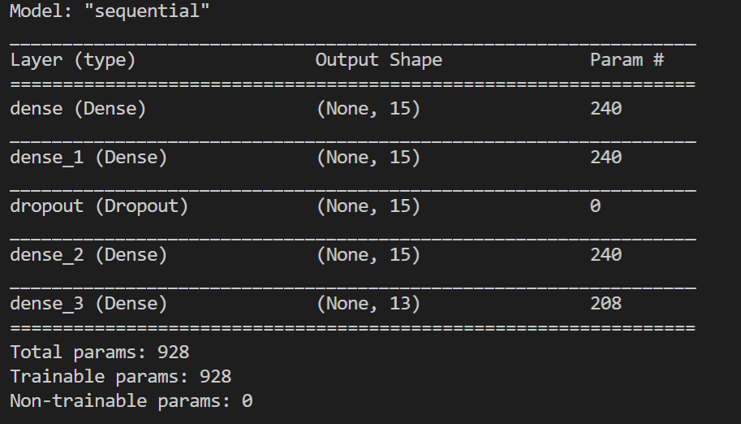
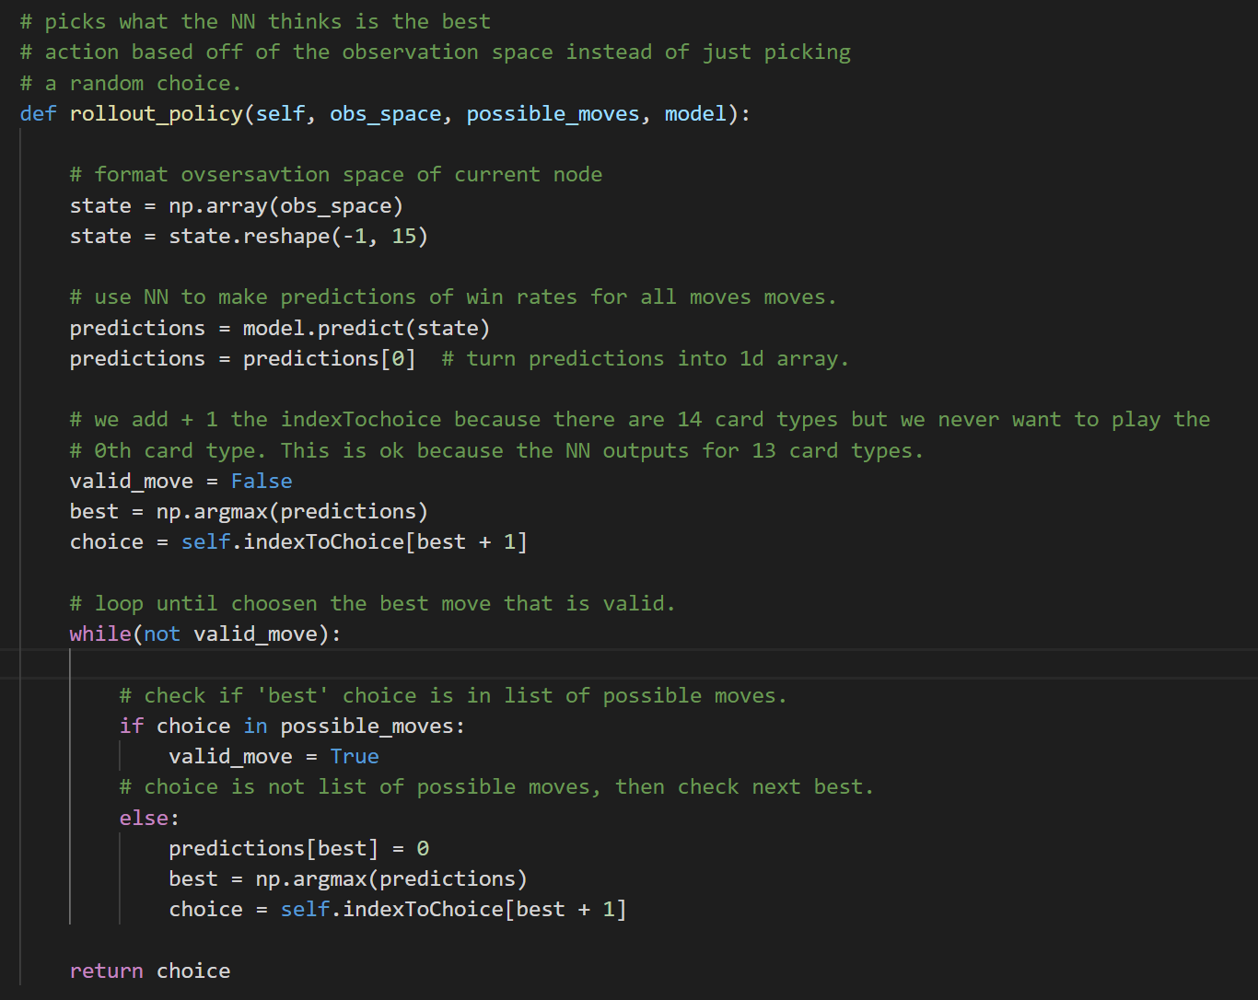
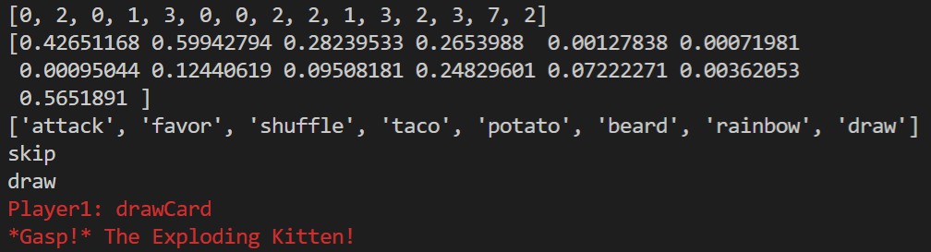
Neural Network Structure and Usage:

Slide 12
04
Generation of Training Data

Slide 13
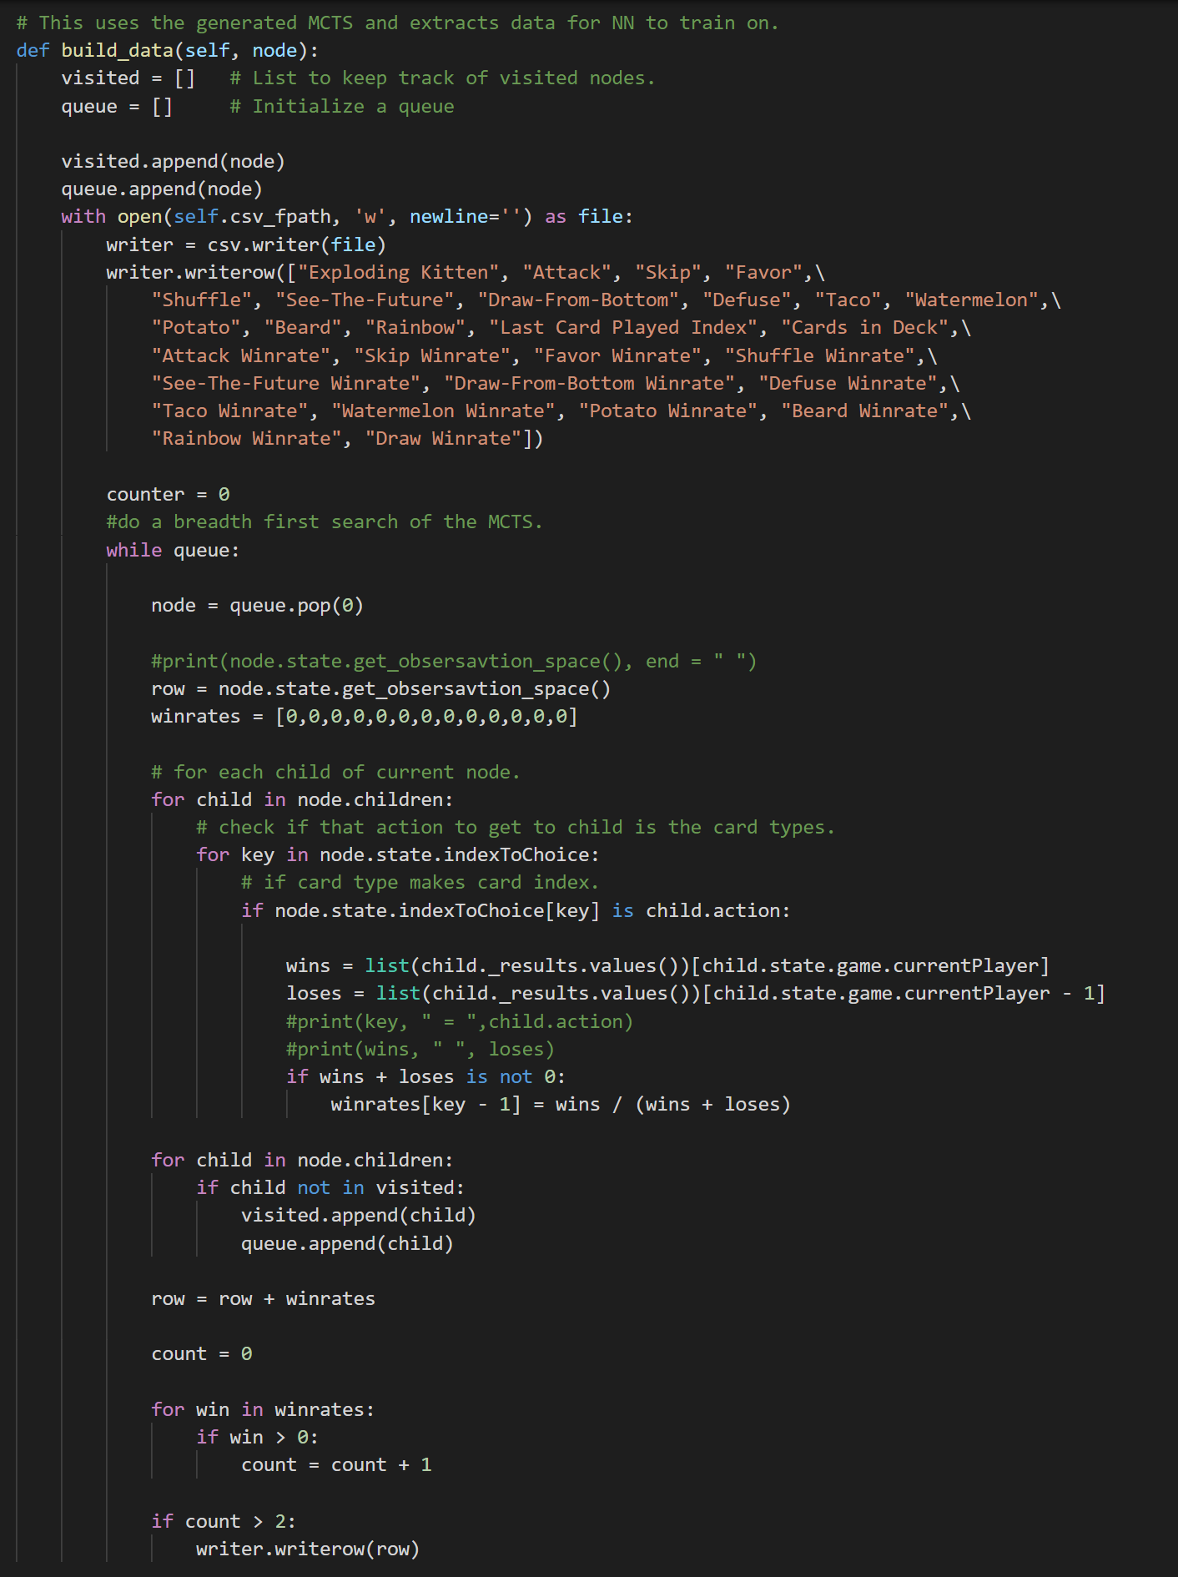
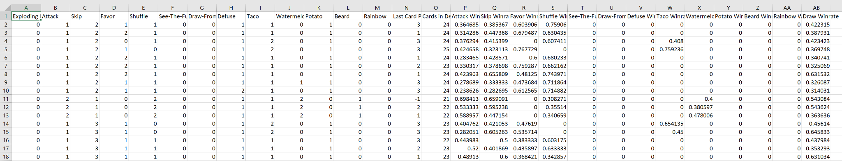
Generation of Training Data:

Slide 14
05
Neural Network Training

Slide 15
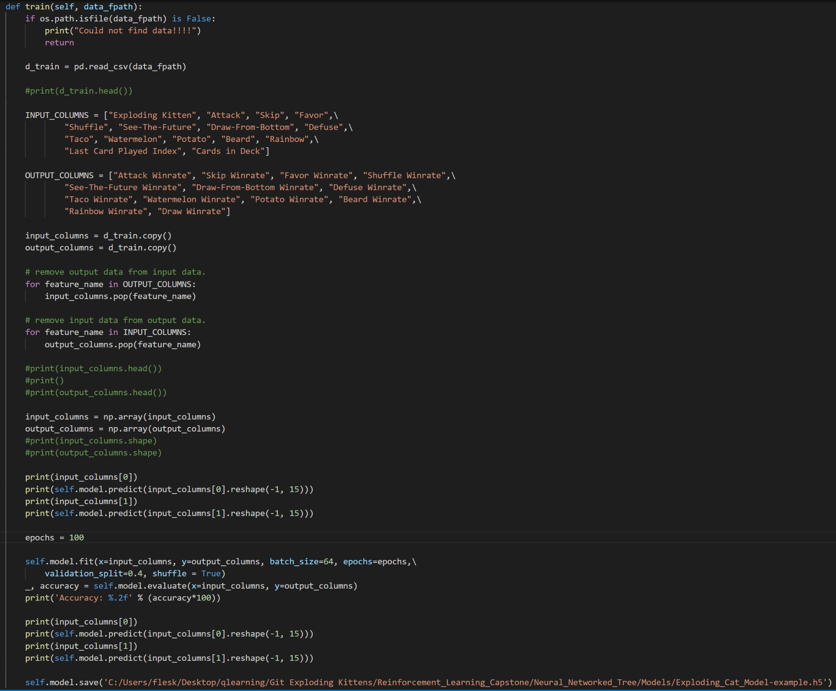
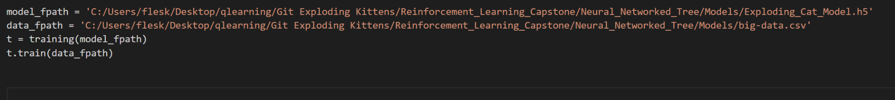
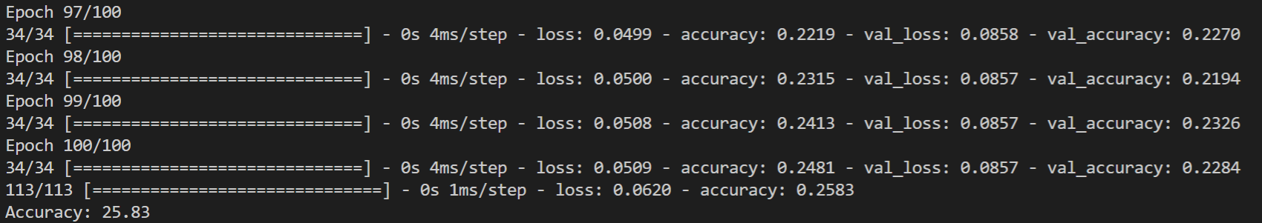
Training the Neural Network:

